Slide 1


DELEGATES AND EVENTS
Sampath Kumar Bingi
AUG, 2018

Slide 2
Agenda
Overview
Common Business Scenarios
Creation of Delegates
Creation of Events
Delegates and Events together
In-Build Delegates

Slide 3
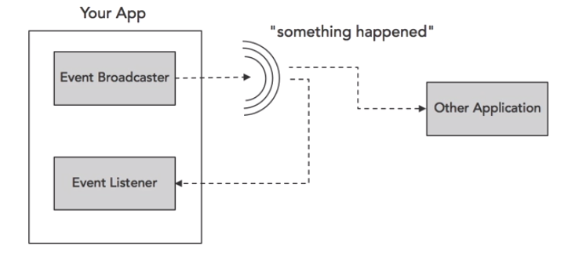
EVENTS
Used to broadcast and listen to messages
Notes:
What is an event ?
1. Events are notifications
2. Play a central role in the .NET framework
3. Provides a way to trigger the notifications from end users or from objects
Role of an event
Events signals the occurrence of an action/notification
Objects that raise the events don’t need to explicitly know the object that will handle the event
Events pass EventArgs as an event data

Slide 4
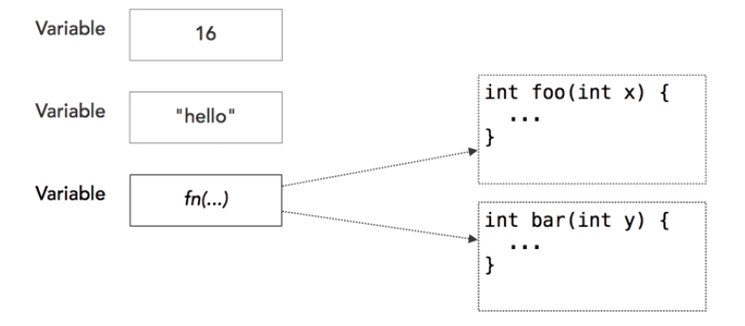
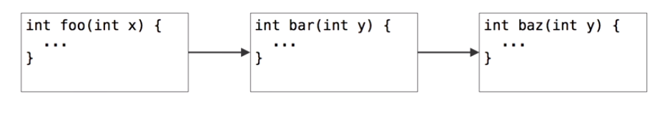
DELEGATES
Delegates: Placeholders for functions
Delegates can be dynamically chained together
Notes:
What is a delegate
A delegate is a type safe function pointer.
That is, it holds a reference(pointer) to a function
A Delegate is a specialized class often called as a “function pointer”
A glue/pipeline between an event and an event handler
Based on Multicast delegate base class
The signature of the delegate must match the signature of the function, the delegate points to, otherwise you get a compiler error.
This is the reason delegates are called as type safe function pointers.
A delegate is similar to a class. You can create an instance of it, and when you do so, you pass in the function name as a parameter to the delegate constructor, and it is to this function the delegate will point to.

Slide 5
EVENT HANDLER
Event handler is responsible for receiving and processing the data from the delegate
EventArgs responsible for encapsulating event data
Event handler receives 2 parameters
Sender and
EventArgs

Slide 6
Delegates
Notes:
What is a delegate
A delegate is a type safe function pointer.
That is, it holds a reference(pointer) to a function
The signature of the delegate must match the signature of the function, the delegate points to, otherwise you get a compiler error.
This is the reason delegates are called as type safe function pointers.
A delegate is similar to a class. You can create an instance of it, and when you do so, you pass in the function name as a parameter to the delegate constructor, and it is to this function the delegate will point to.

Slide 7
What is Delegate ?
A Delegate is a specialized class often called a “Function pointer”
It is a type safe function pointer
A delegate is similar to a class. You can create an instance of it.
Delegates acts as a call back functions

Slide 8
From interface to delegate
Interface disadvantages
Complex (we need create class for realization)
As alternative – use delegates
interface ICalculator { int Calculate(int x, int y, Operation operation); }
delegate int Calculator(int x, int y);

Slide 9
Use delegates
namespace Delegates_Events
{
public delegate void WorkPerformedHandler(int hours, string workToDo);
class Program
{
static void Main(string[] args)
{
WorkPerformedHandler user1 = new WorkPerformedHandler(WorkPerformed1);
WorkPerformedHandler user2 = new WorkPerformedHandler(WorkPerformed2);
user1(10, "Work for user 1");
user2(10, "Work for user 2");
}
static void WorkPerformed1(int hours, string workToDo)
{
Console.WriteLine($"Work 1 {workToDo} in {hours} hours");
}
static void WorkPerformed2(int hours, string workToDo)
{
Console.WriteLine($"Work 2 {workToDo} in {hours} hours");
}
}
}

Slide 10
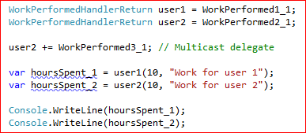
Multicast Delegates
Multicast delegate is an extension of normal delegate. It helps you to point more than one method at a single moment of time.

Slide 11
Multicast Delegates
delegate int ValueDelegate();
Disadvantages
Only one (last) return value
Break execution all delegates if one throw exception
ValueDelegate d = null; d += A1; d += A2; d += A3; Console.WriteLine(d());
ValueDelegate d = null; d += A1; d += A2; d += A3; foreach (ValueDelegate t in d.GetInvocationList()) { Console.WriteLine(t()); }

Slide 12
Multicast delegates with ref
static void func1(int arg1, ref int arg2)
{
int result = arg1 + arg2;
arg2 += 20;
}
static void func2(int arg1, ref int arg2)
{
int result = arg1 * arg2;
}
Use ref variables to pass results from one delegate to other
int a = 10, b = 10;
MyDelegate f1 = func1;
MyDelegate f2 = func2;
MyDelegate combined = f1 + f2;
combined(a, ref b);

Slide 13
Anonymous delegates
delegate void WithoutReturn(int x);
delegate int WithReturn(int x);
WithoutReturn p = delegate (int x) { Console.WriteLine(x); }; WithReturn p2 = delegate (int x) { return x * x; };
Notes:
List.Find()

Slide 14
When to use Delegates ?
Notes:
An eventing design pattern is used.
If the code doesn't need access to any other attributes or method of the class from which logic needs to be processed.
The caller has no need to access other properties, methods, or interfaces on the object implementing the method.
A class may need more than one implementation of the method.
There is a group of related methods that may be called.
A class only needs one implementation of the method.
There are 6 important uses of delegates:- 1. Abstract and encapsulate a method (Anonymous invocation) This is the most important use of delegates; it helps us to define an abstract pointer which can point to methods and functions. The same abstract delegate can be later used to point to that type of functions and methods. In the previous section we have shown a simple example of a maths class. Later addition of new algorithm functions does not affect the UI code. 2. Callback mechanismMany times we would like to provide a call back mechanism. Delegates can be passed to the destination and destination can use the same delegate pointer to make callbacks. 3. Asynchronous processingBy using ‘BeginInvoke’ and ‘EndInvoke’ we can call delegates asynchronously. In our previous section we have explained the same in detail. 4. Multicasting - Sequential processing Some time we would like to call some methods in a sequential manner which can be done by using multicast delegate. This is already explained in the multicast example shown above. 5. Events - Publisher subscriber modelWe can use events to create a pure publisher / subscriber model.

Slide 15
Events
Notes:
C# provides event driven programming by adding support through Events.
It is a way to provide notifications to client when something happens to an object.
Events and Delegates are tightly coupled concept because event handling requires Delegate for the dispatch of Event.
Implementation of Event is a 3 step process.
Declare - public delegate void CallEveryOne()
Create - public Event CallEveryOne objEventCallEveryOne;
Call- objEventCallEveryOne;
Difference between Delegates and Events
When we create an Event, the client can only listen to the Event, where when we create a delegate, the client will get lot of control over application (He can add/remove methods in delegate.).

Slide 16
Introduction to Events
public delegate void WorkPerformedHandler(int hours, string workToDo);
public class Worker { public event WorkPerformedHandler WorkPerformed;
public event EventHandler WorkCompleted; public void DoWork(int hours, string workToDo)
{
for (int i = 0; i < hours; i++)
{
//Raise event WorkPerformed
Console.WriteLine("Work Performed");
}
//Rase event WorkCompleted
} }
private static void Worker_Work()
{
Worker worker = new Worker();
worker.WorkPerformed += Worker_WorkPerformed;
worker.WorkCompleted += Worker_WorkCompleted;
}
private static void Worker_WorkCompleted(object sender, EventArgs e)
{
Console.WriteLine("Work Completed");
}
private static void Worker_WorkPerformed(int hours, string workToDo)
{
Console.WriteLine($"{hours} --> {workToDo}");
}
Notes:
Implementation of Event is a 3 step process.
Declare - public delegate void CallEveryOne()
Create - public Event CallEveryOne objEventCallEveryOne;
Call- objEventCallEveryOne;
Difference between Delegates and Events
When we create an Event, the client can only listen to the Event, where when we create a delegate, the client will get lot of control over application (He can add/remove methods in delegate.).

Slide 17
Event chaining and unchaining
MyClass obj = new MyClass();
// Connect multiple event handlers
obj.valueChanged += changeListener1;
obj.valueChanged += changeListener2;
// Use an anonymous delegate as the event handler
obj.valueChanged += delegate(string s) {
Console.WriteLine("This came from the anonymous handler!");
};
obj.objChanged += delegate(object sender, ObjChangeEventArgs e) {
Console.WriteLine("{0} had the '{1}' property changed", sender.GetType(), e.propChanged);
};

Slide 18
THANK YOU

